Slide 1
Elastic Beanstalk, AWS Messaging services (SNS, SQS, SES) and Data Security.
Bachelor of Engineering - Computer Science & Engineering
Cloud Computing (CC)(23CS009)
Department of Computer Science & Engineering
Chitkara University Institute of Engineering and Technology, Chitkara University, Punjab, India

Slide 2
Elastic Beanstalk
With Elastic Beanstalk you can deploy web applications into the AWS Cloud on a variety of supported platforms. You build and deploy your applications. Elastic Beanstalk provisions Amazon EC2 instances, configures load balancing, sets up health monitoring, and dynamically scales your environment.
In addition to web server environments, Elastic Beanstalk also provides worker environments which you can use to process messages from an Amazon SQS queue, useful for asynchronous or long-running tasks.

Slide 3
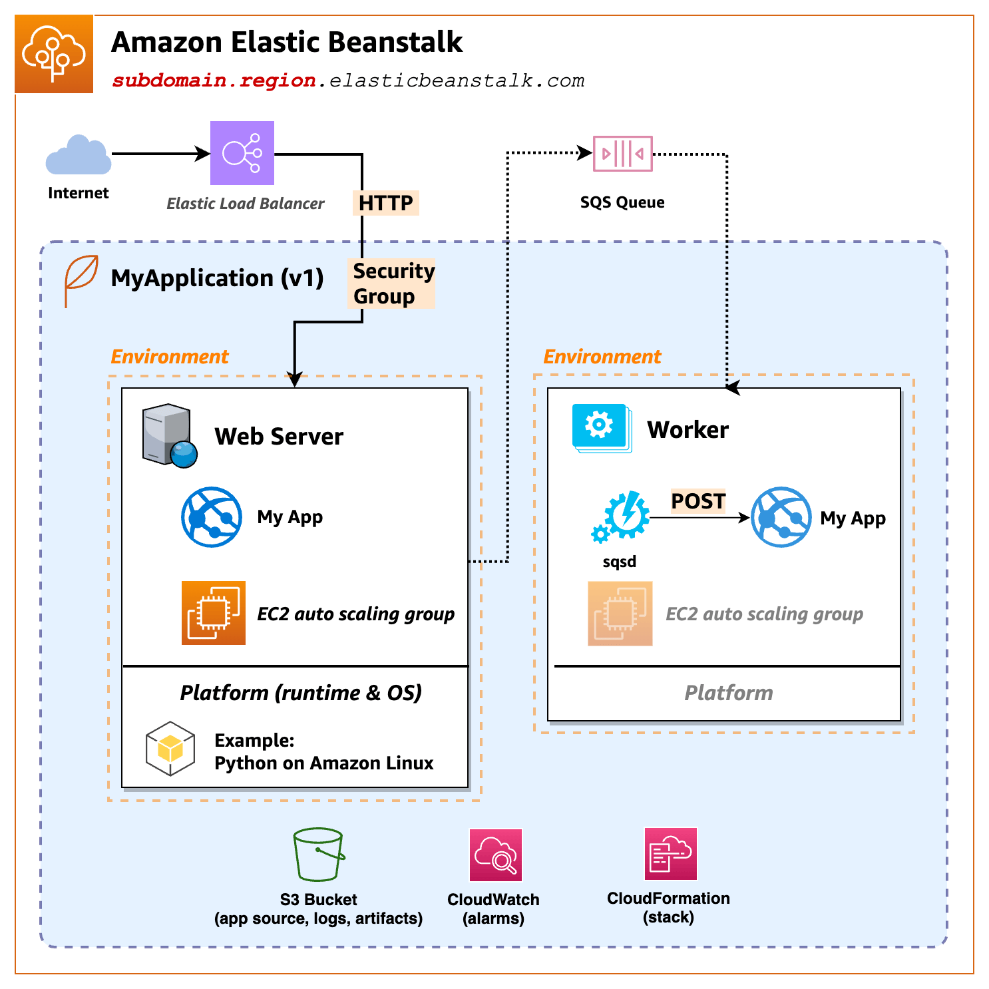

Slide 4
Understanding concepts in Elastic Beanstalk
Application
An Elastic Beanstalk application is a container for Elastic Beanstalk components, including environments, versions, and environment configurations.
Application version
In Elastic Beanstalk, an application version refers to a specific, labeled iteration of deployable code for a web application. An application version points to an Amazon Simple Storage Service (Amazon S3) object that contains the deployable code, such as a Java WAR file.
An application version is part of an application. Applications can have many versions and each application version is unique.
Environment
An environment is a collection of AWS resources running an application version. Each environment runs only one application version at a time, however, you can run the same application version or different application versions in many environments simultaneously.

Slide 5
Environment tier
When you launch an Elastic Beanstalk environment, you first choose an environment tier. The environment tier designates the type of application that the environment runs and determines what resources Elastic Beanstalk provisions to support it. An application that serves HTTP requests runs in a web server environment tier. A backend environment that pulls tasks from an Amazon Simple Queue Service (Amazon SQS) queue runs in a worker environment tier.
Environment configuration
An environment configuration identifies a collection of parameters and settings that define how an environment and its associated resources behave.
Saved configuration
A saved configuration is a template that you can use as a starting point for creating unique environment configurations. You can create and modify saved configurations, and apply them to environments, using the Elastic Beanstalk console, EB CLI, AWS CLI, or API. The API and the AWS CLI refer to saved configurations as configuration templates.

Slide 6
Platform
A platform is a combination of an operating system, programming language runtime, web server, application server, and Elastic Beanstalk components. You design and target your web application to a platform. Elastic Beanstalk provides a variety of platforms on which you can build your applications.

Slide 7
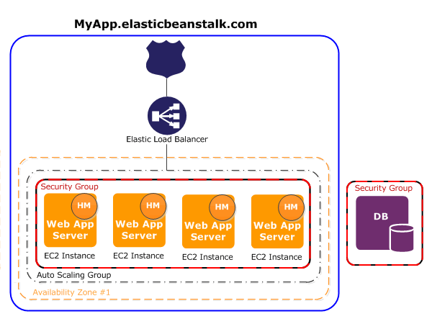
Elastic Beanstalk web server environments
The following diagram shows an example Elastic Beanstalk architecture for a web server environment tier, and shows how the components in that type of environment tier work together.

Slide 8
The environment is the heart of the application. In the diagram, the environment is shown within the top-level solid line. When you create an environment, Elastic Beanstalk provisions the resources required to run your application. AWS resources created for an environment include one elastic load balancer (ELB in the diagram), an Auto Scaling group, and one or more Amazon Elastic Compute Cloud (Amazon EC2) instances.
The load balancer sits in front of the Amazon EC2 instances, which are part of an Auto Scaling group. Amazon EC2 Auto Scaling automatically starts additional Amazon EC2 instances to accommodate increasing load on your application. If the load on your application decreases, Amazon EC2 Auto Scaling stops instances, but always leaves at least one instance running.
Each Amazon EC2 instance that runs your application uses one of these container types. In addition, a software component called the host manager (HM) runs on each Amazon EC2 instance. The host manager is responsible for the following:
Deploying the application
Aggregating events and metrics for retrieval via the console, the API, or the command line
Generating instance-level events
Monitoring the application log files for critical errors
Monitoring the application server
Patching instance components
Rotating your application's log files and publishing them to Amazon S3

Slide 9
AWS Messaging services (SNS, SQS, SES)
Amazon SNS
Amazon Simple Notification Service (Amazon SNS) is a fully managed service that provides message delivery from publishers (producers) to subscribers (consumers). Publishers communicate asynchronously with subscribers by sending messages to a topic, which is a logical access point and communication channel.
How it works?
In SNS, publishers send messages to a topic, which acts as a communication channel. The topic acts as a logical access point, ensuring messages are delivered to multiple subscribers across different platforms.
Subscribers to an SNS topic can receive messages through different endpoints, depending on their use case, such as:
Amazon SQS
Lambda
HTTP(S) endpoints

Slide 10
Email
Mobile push notifications
Mobile text messages (SMS)
Amazon Data Firehose
Service providers (For example, Datadog, MongoDB, Splunk)
SNS supports both Application-to-Application (A2A) and Application-to-Person (A2P) messaging, giving flexibility to send messages between different applications or directly to mobile phones, email addresses, and more.

Slide 11
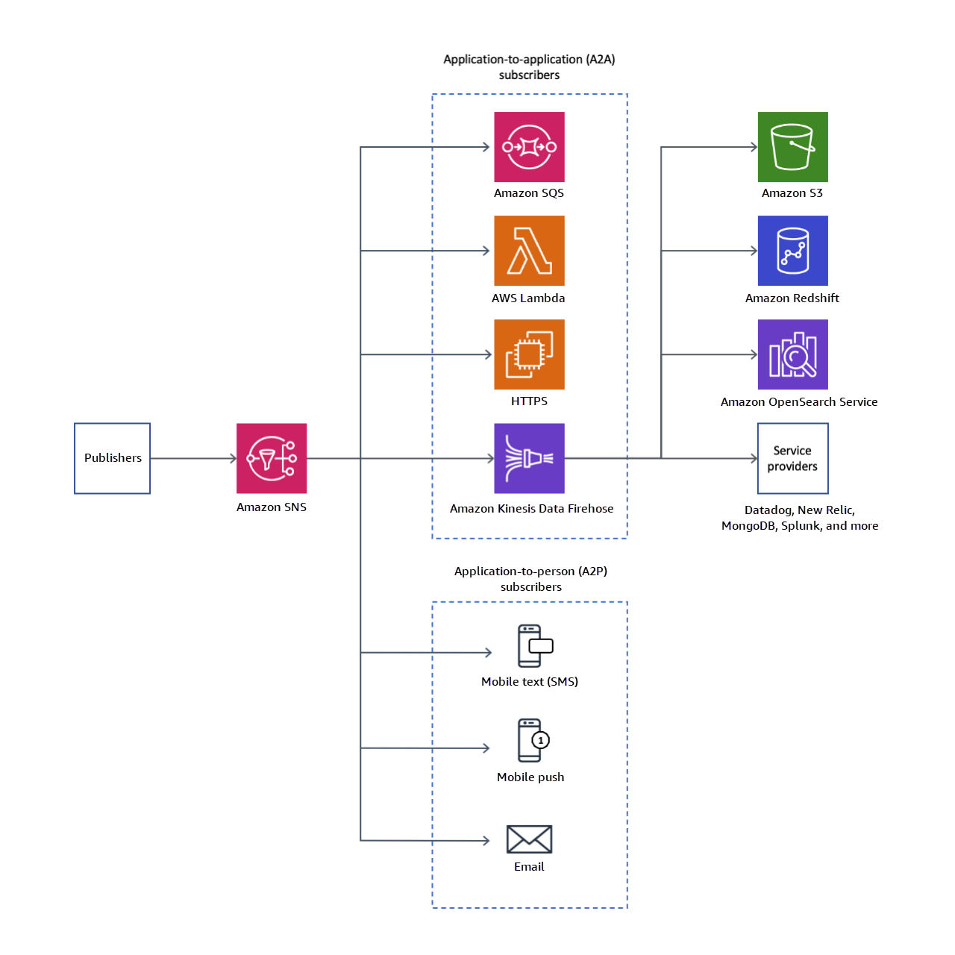

Slide 12
Accessing Amazon SNS
You can access and manage Amazon SNS through the console, AWS CLI, or AWS SDKs, depending on your preferred method of interaction. The console offers a graphical interface for basic tasks, while the AWS CLI and SDKs provide advanced configuration and automation capabilities for more complex use cases.
Create an Amazon SNS topic and publish messages
This topic provides the foundational steps for managing Amazon SNS resources, specifically focusing on topics, subscriptions, and message publishing. First, you will set up the necessary access permissions for Amazon SNS, ensuring that you have the correct permissions to create and manage Amazon SNS resources. Next, you will create a new Amazon SNS topic, which serves as the central hub for managing and delivering messages to subscribers. After creating the topic, you will proceed to create a subscription to this topic, allowing specific endpoints to receive the messages published to it.

Slide 13
Amazon SQS
Amazon Simple Queue Service (Amazon SQS) offers a secure, durable, and available hosted queue that lets you integrate and decouple distributed software systems and components. Amazon SQS offers common constructs such as dead-letter queues and cost allocation tags. It provides a generic web services API that you can access using any programming language that the AWS SDK supports.
Benefits of using Amazon SQS
Security – You control who can send messages to and receive messages from an Amazon SQS queue. You can choose to transmit sensitive data by protecting the contents of messages in queues by using default Amazon SQS managed server-side encryption (SSE), or by using custom SSE keys managed in AWS Key Management Service (AWS KMS).
Durability – For the safety of your messages, Amazon SQS stores them on multiple servers. Standard queues support at-least-once message delivery, and FIFO queues support exactly-once message processing and high-throughput mode.
Availability – Amazon SQS uses redundant infrastructure to provide highly-concurrent access to messages and high availability for producing and consuming messages.

Slide 14
Scalability – Amazon SQS can process each buffered request independently, scaling transparently to handle any load increases or spikes without any provisioning instructions.
Reliability – Amazon SQS locks your messages during processing, so that multiple producers can send and multiple consumers can receive messages at the same time.
Customization – Your queues don't have to be exactly alike—for example, you can set a default delay on a queue. You can store the contents of messages larger than 1 MiB using Amazon Simple Storage Service (Amazon S3) or Amazon DynamoDB, with Amazon SQS holding a pointer to the Amazon S3 object, or you can split a large message into smaller messages.

Slide 15
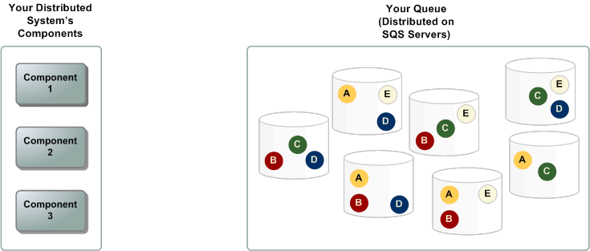
Basic Amazon SQS architecture

Slide 16
Distributed queues
There are three main parts in a distributed messaging system: the components of your distributed system, your queue (distributed on Amazon SQS servers), and the messages in the queue.
In the diagram, your system has several producers (components that send messages to the queue) and consumers (components that receive messages from the queue). The queue (which holds messages A through E) redundantly stores the messages across multiple Amazon SQS servers.

Slide 17
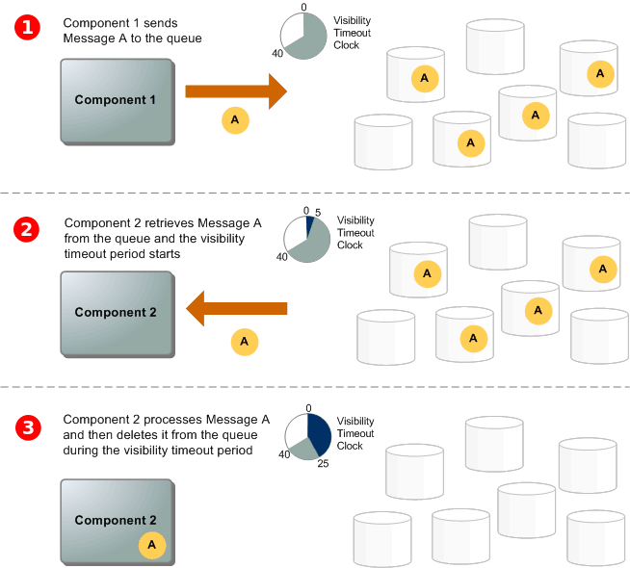
Message Lifecycle

Slide 18
The scenario describes the lifecycle of an Amazon SQS message in a queue, from creation to deletion.
A producer (Component 1) sends message A to a queue, and the message is distributed across the Amazon SQS servers redundantly.
When a consumer (Component 2) is ready to process messages, it consumes messages from the queue, and message A is returned. While message A is being processed, it remains in the queue and isn't returned to subsequent receive requests for the duration of the visibility timeout.
The consumer (Component 2) deletes message A from the queue to prevent the message from being received and processed again when the visibility timeout expires.

Slide 19
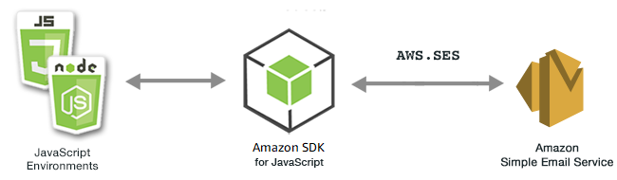
Amazon SES
Amazon Simple Email Service (Amazon SES) is a cloud-based email sending service designed to help digital marketers and application developers send marketing, notification, and transactional emails. It is a reliable, cost-effective service for businesses of all sizes that use email to keep in contact with their customers.

Slide 20
Data Security
At AWS, security is our top priority and security in the cloud is a shared responsibility between AWS and our customer. Financial services providers, healthcare providers, and governmental agencies are among the customers, who trust us with some of their most sensitive information.
Before architecting any workload, foundational practices that influence security should be in place. For example, data classification provides a way to categorize data based on levels of sensitivity, and encryption protects data by way of rendering it unintelligible to unauthorized access. These methods are important because they support objectives such as preventing mishandling or complying with regulatory obligations.
Data classification: Data classification provides a way to categorize organizational data based on criticality and sensitivity in order to help you determine appropriate protection and retention controls.
Protecting data at rest: Data at rest represents any data that you persist in non-volatile storage for any duration in your workload. This includes block storage, object storage, databases, archives, IoT devices, and any other storage medium on which data is persisted. Protecting your data at rest reduces the risk of unauthorized access, when encryption and appropriate access controls are implemented.

Slide 21
Protecting data in transit: Data in transit is any data that is sent from one system to another. This includes communication between resources within your workload as well as communication between other services and your end users. By providing the appropriate level of protection for your data in transit, you protect the confidentiality and integrity of your workload’s data.

Slide 22


